Slide 1
Kindness
One of the Eight Essentials of Leadership

Slide 2
What does kindness mean?
Definition:
(Noun) The quality of being friendly, generous, and considerate.
Synonyms: consideration, helpfulness, thoughtfulness, selflessness, compassion, sympathy, understanding, big-heartedness, friendliness, neighborliness, generosity.

Slide 3
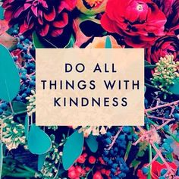
Kindness is important because...
1. Kindness broadens our perspective.
2. Kindness helps people feel respected and less alone.
3. Kindness creates kindness.

Slide 4
Kindness Broadens Our Perspective.
In order to be kind, we have to pay attention to what is happening around us. As we notice more things and help others, we get a glimpse of other ways of looking at things. A broader perspective helps us to keep things in context.

Slide 5
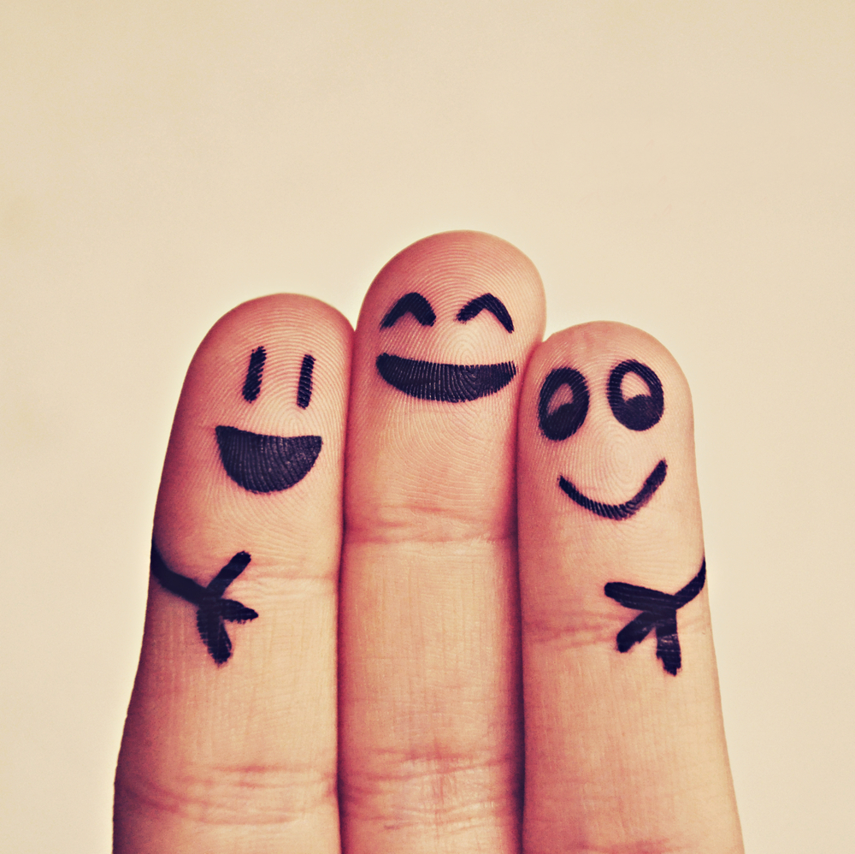
2. Helps People Feel Respected & Less Alone
By recognizing someone's need for help and acting on it in a compassionate manner, it makes the recipient feel valued. It also makes the giver feel better about themselves and more connected.

Slide 6
3. Kindness Creates Kindness.
When you are kind to others, the impact of your action doesn't stop there. Many times the recipient of your kindness and others who see or hear about your kindness are inspired to be kinder. The ripples of kindness are truly endless.

Slide 7
Discussion Questions:
1. Why can it be/is it difficult for us to be kind? When is it the hardest to be kind?
2. Do you think it’s hard for people in our society to accept acts of kindness? Why?

