Slide 1
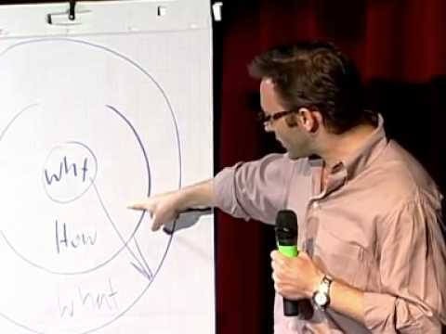
Golden Circle

Slide 2
What is your WHY?
What is your WHY?
Why are YOU in this class?
What inspired you to apply?
Why do you care about the school?

Slide 3
Example:
What: Coach volleyball
How: Practice, giving feedback, watching film, traveling, scouting reports...
Why: I truly care about the development of my players as people and athletes. I want to give the same type of “invaluable” experiences that I had in my athletic career.

Slide 4
Two minute quiet brainstorm…
What is your WHY?
But before you start...

Slide 5
Don’t write things down because you think it is “right” or supposed to be written on your paper.
Some of you are going to say or write things that just aren’t genuine.
Be YOU.
Be proud of your WHY.
If you don’t know- that’s okay. But there is a reason you applied to this class. Dig deep. What is that reason?
Your why will take time to develop. This is below surface level thinking.

Slide 6
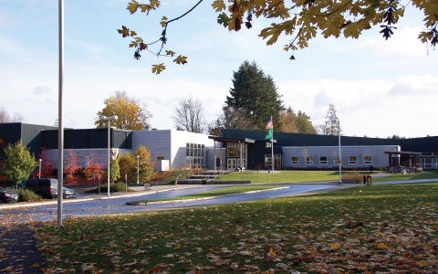
What is our class WHY?
What is our class why?
Why does WMS have a leadership class?
What are we trying to do?
What is our vision?
What do we believe?

Slide 7
Two minute quiet brainstorm…
What is OUR why?

Slide 8
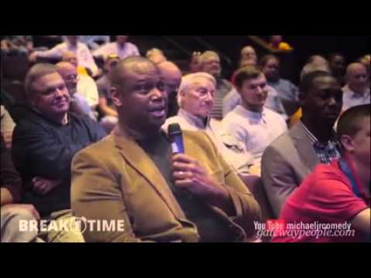
Know Your Why

Slide 9
Sticky Note Project
OCTOBER 2016

Slide 10
With Your Tablemates
Why:
How:
What: Sticky Note Project- A written compliment individualized for every WMS student and staff.

Slide 11
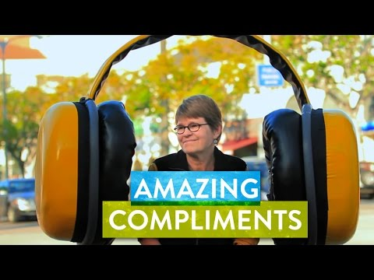

Slide 12
Group Assignments
8th Grade
Amelia and Jackson
Hannah
Braden and Zack
Callie
Sam and Ashlyn
Veronika
Landrey
Olivia S
Sailor and Grant
Audrey and Titus
Tina
Molly and Frances
7th Grade
Hunter
Olivia C.
Lyv
Mruthula
Cameron
Jack
Ryan
Kiani
Bess
Kiani and Mruthula
Bess and Cameron
Lyv and Ryan
Jack and Bess
Olivia C.
Hunter
6th Grade
Everyone will take one group after 7th-8th grade are complete.

Slide 13
Order of Operations...
Look through names on list
Do you know each person?
Can you make an effort to meet/get to know this person better?
List positive qualities or characteristics that this person represents on scratch paper.
Pick out paper color and pen or marker.
Write legible, positive, uplifting, note. (NO INSIDE JOKES OR SARCASM!!!)
Sign the note: Sincerely, From, Have a great day… something nice!

Slide 14
Order of Operations Continued...
6. Do NOT sign your name- use “Your Peers” or “WMS Leadership” (Which do we like better???)
7. Keep in paperclip with other group members!! (Get paper clip from Herseth)
8. Once you have finished entire group- we will work on locker numbers!
LET’S DO IT!!!

